Slide 1
Detection of Autism Spectrum Disorder using fMRI Functional Connectivity with Feature Selection and Deep Learning
Machine vision
FATEMEH EHTESHAMINIA
Spring 1403

Slide 2
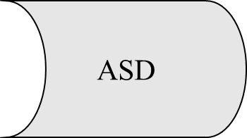

INTRODUCTION
FMRI
Autism Spectrum Disorder
functional magnetic resonance imaging
Autism Brain Imaging Data Exchange

Slide 3
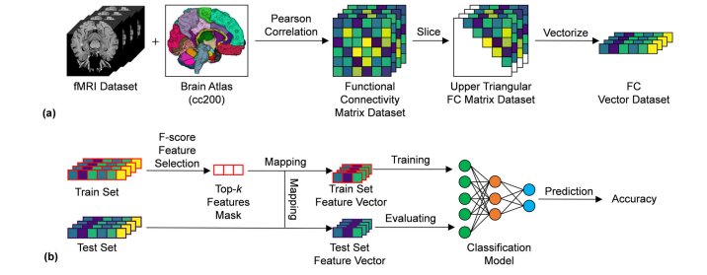
Pipeline of the proposed method for ASD classifcation
(a) The original fMRI dataset is segmented by using a brain atlas, and pairwise Pearson’s correlations for each subject in the dataset are computed. The vectorized upper triangular FC matrix is used for further feature selection
(b) Firstly, the original FC vector dataset is split into a training set and a test set. Then, using the F-score feature selection method, the FC items in the training set with the top k largest F-score values are picked to form a feature mask, which is applied on the training set to select the discriminative FC features

Slide 4
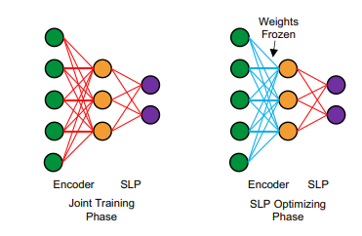
The training model strategy consists of joint training phase and SLP optimizing phase

Slide 5
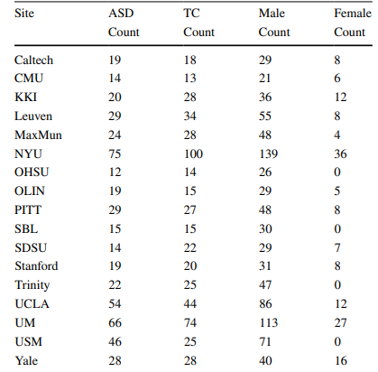
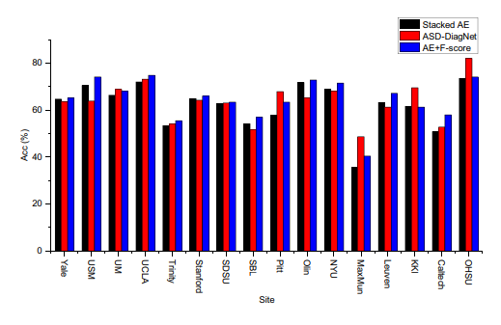
Intra‑Site Evaluation Results
Class information of ABIDE-I datasets for each site

Slide 6
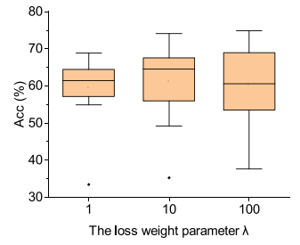
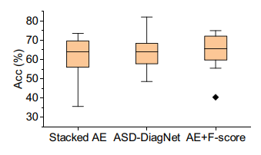
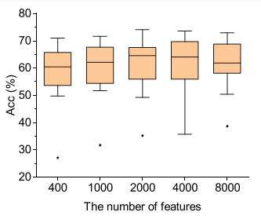
The average accuracy among each site using AE, ASDDiagNet and the proposed method (AE+F-score)
The accuracy results with diferent number of features among all sites
The accuracy results with diferent values of the loss balance parameter among all sites

Slide 7
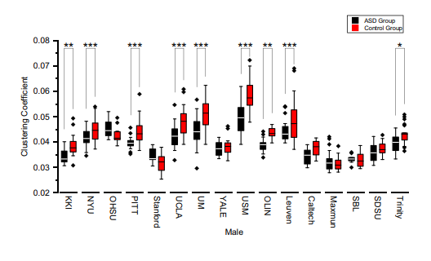
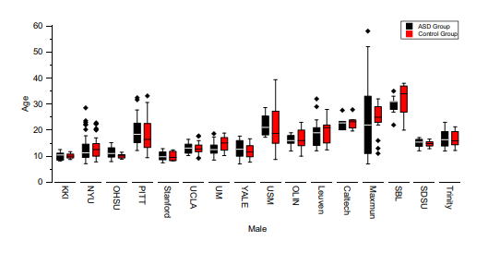
The average shortest path lengths for males in the ASD (black) and TD (red) groups for each site

Slide 8
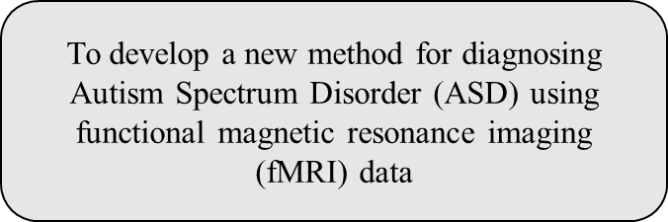

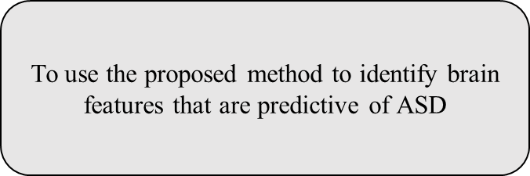
To investigate the altered brain networks in ASD

Slide 9
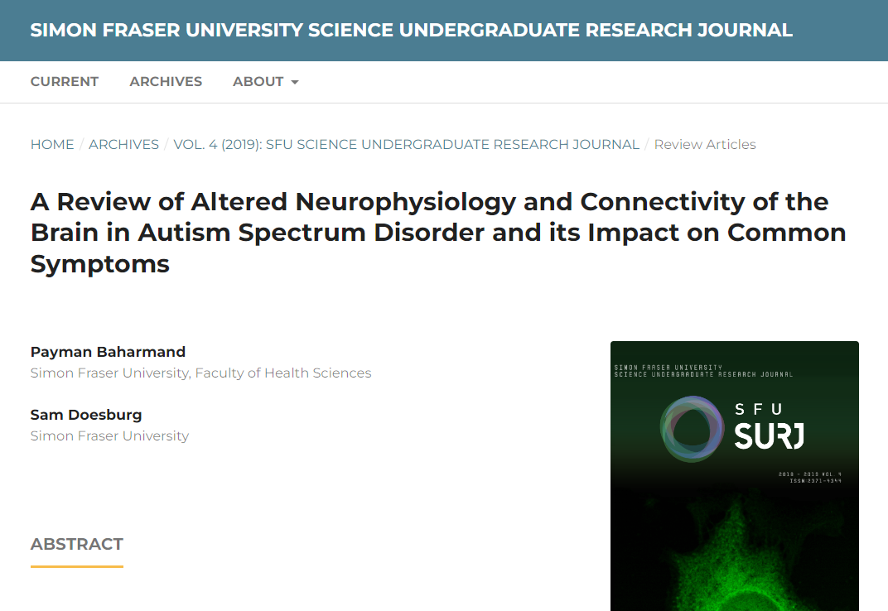
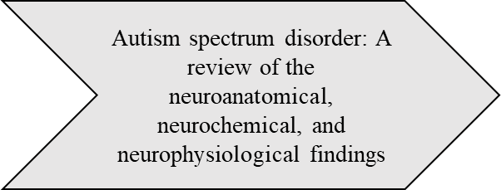
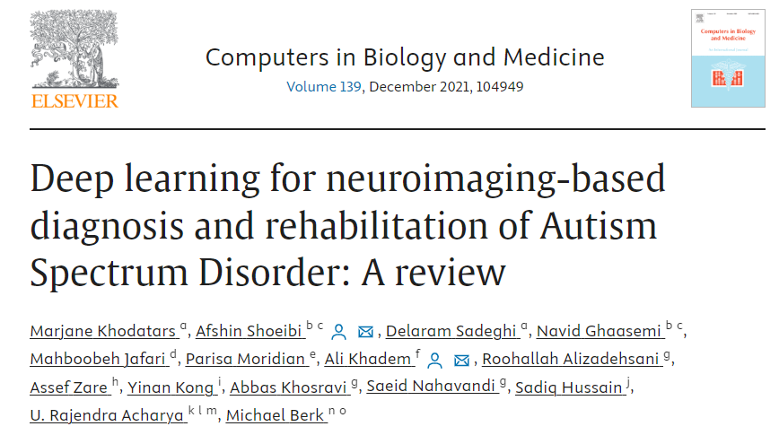
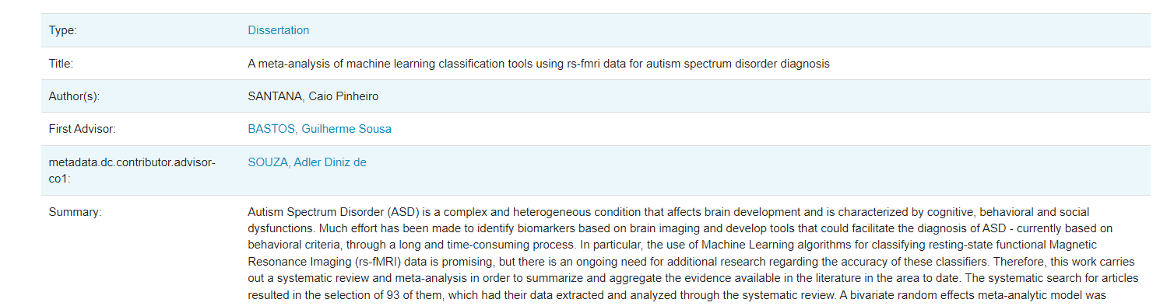
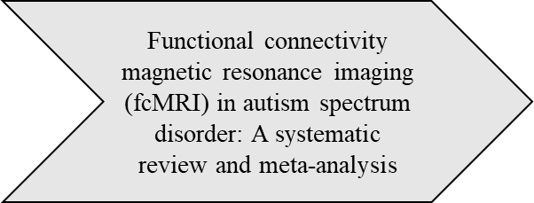
Deep learning for autism spectrum disorder diagnosis: A review

Slide 10
THANKS FOR YOUR ATTENTION

